Slide 1
C
FILE I/O

Slide 2
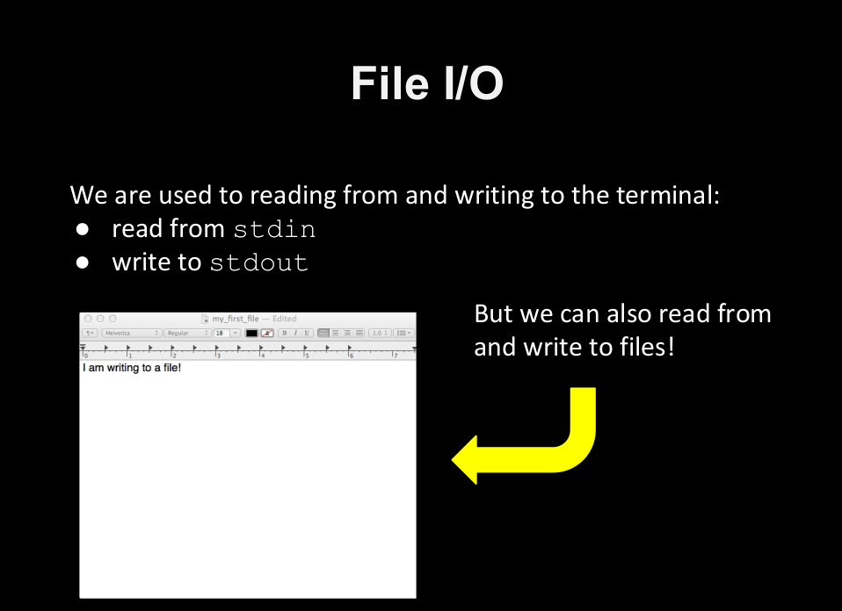

Slide 3
C Header Files
<assert.h> Program assertion functions
<ctype.h> Character type functions
<locale.h> Localization functions
<math.h> Mathematics functions
<setjmp.h> Jump functions
<signal.h> Signal handling functions
<stdarg.h> Variable arguments handling functions
<stdio.h> Standard Input/Output functions
<stdlib.h> Standard Utility functions
<string.h> String handling functions
<time.h> Date time functions
Files in C
Stream oriented data (Text) System oriented data (Binary)
What does C language support?

Slide 4
C Header Files
<assert.h> Program assertion functions
<ctype.h> Character type functions
<locale.h> Localization functions
<math.h> Mathematics functions
<setjmp.h> Jump functions
<signal.h> Signal handling functions
<stdarg.h> Variable arguments handling functions
<stdio.h> Standard Input/Output functions
<stdlib.h> Standard Utility functions
<string.h> String handling functions
<time.h> Date time functions
1. Creation of a new file.
2. Opening an existing file.
3. Reading data from a file.
4. Writing data in a file.
5. Closing a file.
File operations
Five major operations can be performed on file

Slide 5
C Header Files
<assert.h> Program assertion functions
<ctype.h> Character type functions
<locale.h> Localization functions
<math.h> Mathematics functions
<setjmp.h> Jump functions
<signal.h> Signal handling functions
<stdarg.h> Variable arguments handling functions
<stdio.h> Standard Input/Output functions
<stdlib.h> Standard Utility functions
<string.h> String handling functions
<time.h> Date time functions
Declare a file pointer variable.
Open a file using fopen() function.
Process the file using the suitable function.
Close the file using fclose() function.
Processing
How to process for a file in C language?

Slide 6
C Header Files
<assert.h> Program assertion functions
<ctype.h> Character type functions
<locale.h> Localization functions
<math.h> Mathematics functions
<setjmp.h> Jump functions
<signal.h> Signal handling functions
<stdarg.h> Variable arguments handling functions
<stdio.h> Standard Input/Output functions
<stdlib.h> Standard Utility functions
<string.h> String handling functions
<time.h> Date time functions
Declarations
FILE *fp;
In C language, we use a structure pointer of file type to declare a file.

Slide 7
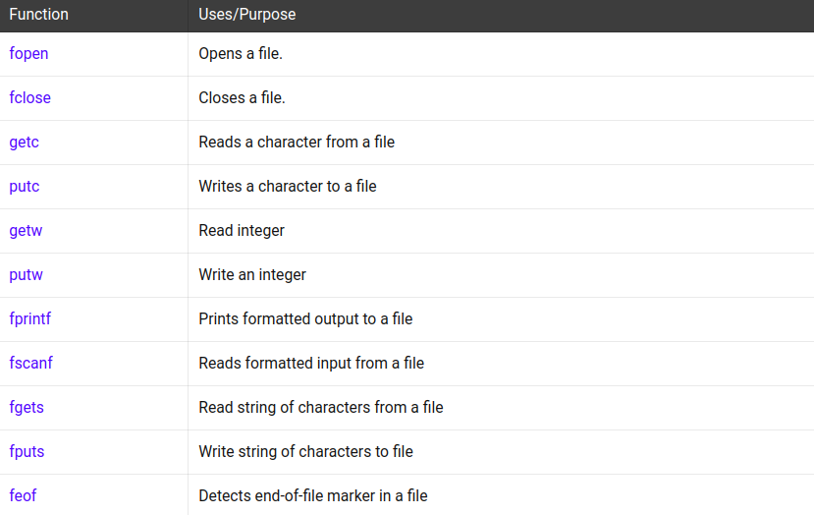
C Header Files
<assert.h> Program assertion functions
<ctype.h> Character type functions
<locale.h> Localization functions
<math.h> Mathematics functions
<setjmp.h> Jump functions
<signal.h> Signal handling functions
<stdarg.h> Variable arguments handling functions
<stdio.h> Standard Input/Output functions
<stdlib.h> Standard Utility functions
<string.h> String handling functions
<time.h> Date time functions
Initialization
struct complex *cPtr = &c;
cPtr->imag = 1;
(*cPtr).imag = 2;
Structs in C

Slide 8
C Header Files
<assert.h> Program assertion functions
<ctype.h> Character type functions
<locale.h> Localization functions
<math.h> Mathematics functions
<setjmp.h> Jump functions
<signal.h> Signal handling functions
<stdarg.h> Variable arguments handling functions
<stdio.h> Standard Input/Output functions
<stdlib.h> Standard Utility functions
<string.h> String handling functions
<time.h> Date time functions
fopen()
FILE *fopen( const char* filePath, const char* mode);
C fopen is a C library function used to open an existing file or create a new file.

Slide 9
C Header Files
<assert.h> Program assertion functions
<ctype.h> Character type functions
<locale.h> Localization functions
<math.h> Mathematics functions
<setjmp.h> Jump functions
<signal.h> Signal handling functions
<stdarg.h> Variable arguments handling functions
<stdio.h> Standard Input/Output functions
<stdlib.h> Standard Utility functions
<string.h> String handling functions
<time.h> Date time functions
filePath: The first argument is a pointer to a string containing the name of the file to be opened.
mode: The second argument is an access mode.
Parameters
C fopen is a C library function used to open an existing file or create a new file.

Slide 10
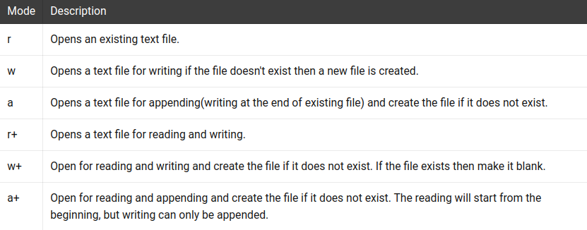
https://github.com/NARKOZ/hacker-scripts

Slide 11
C Header Files
<assert.h> Program assertion functions
<ctype.h> Character type functions
<locale.h> Localization functions
<math.h> Mathematics functions
<setjmp.h> Jump functions
<signal.h> Signal handling functions
<stdarg.h> Variable arguments handling functions
<stdio.h> Standard Input/Output functions
<stdlib.h> Standard Utility functions
<string.h> String handling functions
<time.h> Date time functions
Example
Example 7.1
opening a file.

Slide 12
C Header Files
<assert.h> Program assertion functions
<ctype.h> Character type functions
<locale.h> Localization functions
<math.h> Mathematics functions
<setjmp.h> Jump functions
<signal.h> Signal handling functions
<stdarg.h> Variable arguments handling functions
<stdio.h> Standard Input/Output functions
<stdlib.h> Standard Utility functions
<string.h> String handling functions
<time.h> Date time functions
fclose()
int fclose( FILE *fp);
C fopen is a C library function used to open an existing file or create a new file.

Slide 13
C Header Files
<assert.h> Program assertion functions
<ctype.h> Character type functions
<locale.h> Localization functions
<math.h> Mathematics functions
<setjmp.h> Jump functions
<signal.h> Signal handling functions
<stdarg.h> Variable arguments handling functions
<stdio.h> Standard Input/Output functions
<stdlib.h> Standard Utility functions
<string.h> String handling functions
<time.h> Date time functions
Parameters
fp: pointer to a file (which we want to close);
C fclose is a C library function used to close a file

Slide 14
C Header Files
<assert.h> Program assertion functions
<ctype.h> Character type functions
<locale.h> Localization functions
<math.h> Mathematics functions
<setjmp.h> Jump functions
<signal.h> Signal handling functions
<stdarg.h> Variable arguments handling functions
<stdio.h> Standard Input/Output functions
<stdlib.h> Standard Utility functions
<string.h> String handling functions
<time.h> Date time functions
Outputs
On success, returns 0 On failure, returns EOF
C fclose is a C library function used to close a file

Slide 15
C Header Files
<assert.h> Program assertion functions
<ctype.h> Character type functions
<locale.h> Localization functions
<math.h> Mathematics functions
<setjmp.h> Jump functions
<signal.h> Signal handling functions
<stdarg.h> Variable arguments handling functions
<stdio.h> Standard Input/Output functions
<stdlib.h> Standard Utility functions
<string.h> String handling functions
<time.h> Date time functions
Example
Example 7.2
closing a file.

Slide 16
C Header Files
<assert.h> Program assertion functions
<ctype.h> Character type functions
<locale.h> Localization functions
<math.h> Mathematics functions
<setjmp.h> Jump functions
<signal.h> Signal handling functions
<stdarg.h> Variable arguments handling functions
<stdio.h> Standard Input/Output functions
<stdlib.h> Standard Utility functions
<string.h> String handling functions
<time.h> Date time functions
getc()
int getc( FILE * stream );
getc() function is C library function, and it's used to read a character from a file that has been opened in read mode by fopen() function.

Slide 17
C Header Files
<assert.h> Program assertion functions
<ctype.h> Character type functions
<locale.h> Localization functions
<math.h> Mathematics functions
<setjmp.h> Jump functions
<signal.h> Signal handling functions
<stdarg.h> Variable arguments handling functions
<stdio.h> Standard Input/Output functions
<stdlib.h> Standard Utility functions
<string.h> String handling functions
<time.h> Date time functions
Parameters
stream: pointer to a file
getc() function is C library function, and it's used to read a character from a file that has been opened in read mode by fopen() function.

Slide 18
C Header Files
<assert.h> Program assertion functions
<ctype.h> Character type functions
<locale.h> Localization functions
<math.h> Mathematics functions
<setjmp.h> Jump functions
<signal.h> Signal handling functions
<stdarg.h> Variable arguments handling functions
<stdio.h> Standard Input/Output functions
<stdlib.h> Standard Utility functions
<string.h> String handling functions
<time.h> Date time functions
Outputs
returns next requested object from the stream on success.
getc() function is C library function, and it's used to read a character from a file that has been opened in read mode by fopen() function.

Slide 19
C Header Files
<assert.h> Program assertion functions
<ctype.h> Character type functions
<locale.h> Localization functions
<math.h> Mathematics functions
<setjmp.h> Jump functions
<signal.h> Signal handling functions
<stdarg.h> Variable arguments handling functions
<stdio.h> Standard Input/Output functions
<stdlib.h> Standard Utility functions
<string.h> String handling functions
<time.h> Date time functions
Example
Example 7.3

Slide 20
C Header Files
<assert.h> Program assertion functions
<ctype.h> Character type functions
<locale.h> Localization functions
<math.h> Mathematics functions
<setjmp.h> Jump functions
<signal.h> Signal handling functions
<stdarg.h> Variable arguments handling functions
<stdio.h> Standard Input/Output functions
<stdlib.h> Standard Utility functions
<string.h> String handling functions
<time.h> Date time functions
putc()
int putc( int c, FILE * stream );
putc() function is C library function, and it's used to write a character to the file.

Slide 21
C Header Files
<assert.h> Program assertion functions
<ctype.h> Character type functions
<locale.h> Localization functions
<math.h> Mathematics functions
<setjmp.h> Jump functions
<signal.h> Signal handling functions
<stdarg.h> Variable arguments handling functions
<stdio.h> Standard Input/Output functions
<stdlib.h> Standard Utility functions
<string.h> String handling functions
<time.h> Date time functions
Parameters
stream: pointer to a file c: written character
putc() function is C library function, and it's used to write a character to the file.

Slide 22
C Header Files
<assert.h> Program assertion functions
<ctype.h> Character type functions
<locale.h> Localization functions
<math.h> Mathematics functions
<setjmp.h> Jump functions
<signal.h> Signal handling functions
<stdarg.h> Variable arguments handling functions
<stdio.h> Standard Input/Output functions
<stdlib.h> Standard Utility functions
<string.h> String handling functions
<time.h> Date time functions
Example
Example 7.4

Slide 23
C Header Files
<assert.h> Program assertion functions
<ctype.h> Character type functions
<locale.h> Localization functions
<math.h> Mathematics functions
<setjmp.h> Jump functions
<signal.h> Signal handling functions
<stdarg.h> Variable arguments handling functions
<stdio.h> Standard Input/Output functions
<stdlib.h> Standard Utility functions
<string.h> String handling functions
<time.h> Date time functions
fprintf()
int fpritnf( FILE * stream, const char * format );
C fprintf function pass arguments according to the specified format to the file indicated by the stream.

Slide 24
C Header Files
<assert.h> Program assertion functions
<ctype.h> Character type functions
<locale.h> Localization functions
<math.h> Mathematics functions
<setjmp.h> Jump functions
<signal.h> Signal handling functions
<stdarg.h> Variable arguments handling functions
<stdio.h> Standard Input/Output functions
<stdlib.h> Standard Utility functions
<string.h> String handling functions
<time.h> Date time functions
Parameters
stream: pointer to a file format: formation
C fprintf function pass arguments according to the specified format to the file indicated by the stream.

Slide 25
C Header Files
<assert.h> Program assertion functions
<ctype.h> Character type functions
<locale.h> Localization functions
<math.h> Mathematics functions
<setjmp.h> Jump functions
<signal.h> Signal handling functions
<stdarg.h> Variable arguments handling functions
<stdio.h> Standard Input/Output functions
<stdlib.h> Standard Utility functions
<string.h> String handling functions
<time.h> Date time functions
Example
Example 7.5

Slide 26
C Header Files
<assert.h> Program assertion functions
<ctype.h> Character type functions
<locale.h> Localization functions
<math.h> Mathematics functions
<setjmp.h> Jump functions
<signal.h> Signal handling functions
<stdarg.h> Variable arguments handling functions
<stdio.h> Standard Input/Output functions
<stdlib.h> Standard Utility functions
<string.h> String handling functions
<time.h> Date time functions
fscanf()
int fscanf( FILE * stream, const char * format );
C fscanf function reads formatted input from a file

Slide 27
C Header Files
<assert.h> Program assertion functions
<ctype.h> Character type functions
<locale.h> Localization functions
<math.h> Mathematics functions
<setjmp.h> Jump functions
<signal.h> Signal handling functions
<stdarg.h> Variable arguments handling functions
<stdio.h> Standard Input/Output functions
<stdlib.h> Standard Utility functions
<string.h> String handling functions
<time.h> Date time functions
Parameters
stream: pointer to a file format: formation
C fscanf function reads formatted input from a file

Slide 28
C Header Files
<assert.h> Program assertion functions
<ctype.h> Character type functions
<locale.h> Localization functions
<math.h> Mathematics functions
<setjmp.h> Jump functions
<signal.h> Signal handling functions
<stdarg.h> Variable arguments handling functions
<stdio.h> Standard Input/Output functions
<stdlib.h> Standard Utility functions
<string.h> String handling functions
<time.h> Date time functions
Outputs
Its return the number of variables that are assigned values, or EOF if no assignments could be made.
C fscanf function reads formatted input from a file

Slide 29
C Header Files
<assert.h> Program assertion functions
<ctype.h> Character type functions
<locale.h> Localization functions
<math.h> Mathematics functions
<setjmp.h> Jump functions
<signal.h> Signal handling functions
<stdarg.h> Variable arguments handling functions
<stdio.h> Standard Input/Output functions
<stdlib.h> Standard Utility functions
<string.h> String handling functions
<time.h> Date time functions
Example
Example 7.6

Slide 30
Questions?

Slide 31
KTHANXBYE

